Slide 1
Explore fundamental concepts in algorithms and data structures.
Module 1: Introduction to Algorithms
Week 1
Understand core data structures and their operations.
Module 2: Basic Data Structures
Week 2
Discover basic sorting techniques and performance analysis.
Module 3: Sorting Algorithms P1
Week 3
Examine advanced sorting methods and efficiency improvements.
Module 4: Sorting Algorithms P2
Week 4
Learn fundamental searching algorithms for data retrieval.
Module 5: Searching Algorithms P1
Week 5
Explore advanced search structures and optimization strategies.
Module 6: Searching Algorithms P2
Week 6
Public Holiday
Week 7
No class scheduled due to a public holiday.
Grasp basic graph theory and traversal techniques.
Module 7&8: Graph Algorithms P1
Week 8
Dive into advanced graph algorithms, including shortest path methods.
Module 9: Graph Algorithms P2
(lecture on Tuesday)
Week 9
Study string matching and pattern searching techniques.
Module 10: String Process
Week 10
Investigate dynamic programming and other sophisticated algorithm strategies.
Module 11: Advanced Algorithms
Week 11
Notes:
This module explores advanced searching structures, including Binary Search Trees (BSTs), Balanced Search Trees, Heaps, and Priority Queues. These data structures optimize search efficiency, insertion, and deletion operations, addressing issues like imbalance and priority-based processing in computational applications.

Slide 2
Module 6: SEARCHING ALGORITHMS (CONT’D)
Note: Some of these slides have been adapted from
slides freely available on the Internet and also from the
slides accompanying the course textbook.
Notes:
This module explores advanced searching structures, including Binary Search Trees (BSTs), Balanced Search Trees, Heaps, and Priority Queues. These data structures optimize search efficiency, insertion, and deletion operations, addressing issues like imbalance and priority-based processing in computational applications.

Slide 3
Revise previous module
Binary Search: Efficient search method for sorted arrays; eliminates half the elements per step (O(log n) complexity).
Hashing & Hash Tables: Uses hash functions for fast lookups (O(1) in ideal cases); methods include open addressing and chaining for collision handling.
Tree Traversals:
Pre-order: Root → Left → Right
In-order: Left → Root → Right
Post-order: Left → Right → Root
Perfect Binary Trees: Special case where all levels are fully populated, analyzed mathematically using recursion and induction
Notes:
Before we dive into Module 6, let’s take a moment to review key concepts from Module 5 on Searching Algorithms.
Binary Search
One of the most efficient searching methods for sorted arrays.
It repeatedly divides the search space in half, eliminating half of the remaining elements at each step.
This results in a logarithmic time complexity of O(log n), making it much faster than linear search for large datasets.
Hashing & Hash Tables
Hash functions allow constant-time lookups (O(1) in the best case).
Hash tables store key-value pairs and resolve collisions through open addressing (probing for empty slots) or chaining (using linked lists).
Tree Traversals
Essential for navigating and processing tree structures.
Pre-order traversal: Visits the root first, then explores the left and right subtrees (Root → Left → Right).
In-order traversal: Processes the left subtree, then the root, and finally the right subtree (Left → Root → Right).
Post-order traversal: Explores the left and right subtrees before visiting the root (Left → Right → Root).
Perfect Binary Trees
A special type of tree where all levels are fully populated.
These trees follow specific mathematical properties and can be analyzed using recursion and induction to determine their height, number of nodes, and other characteristics.

Slide 4
Learning Outcomes
After completing this module, you will be able to:
Understand the basic structure and operations of Binary Search Trees
Recognize how Balanced Search Trees maintain efficient search, insertion, and deletion
Describe the core properties of Heaps and how they are constructed
Understand the purpose and functionality of Priority Queues
Notes:
Binary Search Trees (BSTs)
Understand how BSTs store and organize data.
Learn how search, insertion, and deletion work in BSTs.
Balanced Search Trees
Recognize why balancing is essential for maintaining efficient operations.
Learn about AVL Trees and Red-Black Trees, which ensure logarithmic time complexity.
Heaps and Their Properties
Explore the heap structure, where the smallest (or largest) element is always at the root.
Learn how heap insertions and deletions maintain order.
Priority Queues
Understand how priority queues use heaps for efficient access to the highest-priority element.
Recognize their importance in applications like task scheduling and shortest path algorithms.

Slide 5
Topics
Binary Search Trees
Balanced Search Trees
Heaps
Priority Queues
Notes:
In this module, we will explore four fundamental data structures that enhance searching efficiency. These structures are essential for organizing and managing data efficiently in various computing applications.
Binary Search Trees (BSTs) - A hierarchical data structure where each node has at most two children.
Balanced Search Trees - Ensures that the tree remains balanced, preventing worst-case O(n) search times.
Heaps - A specialized binary tree used for priority-based operations.
Priority Queues - A data structure where elements are accessed based on their priority rather than their order of insertion.

Slide 6
Binary Search Tree
Binary search trees (BSTs) are binary trees with a special property
For each node
All descendants in its left subtree have a lower value
All descendants in its right subtree have a higher value
An in-order traversal will output the nodes in increasing order, hence the name “in-order”
F
B
H
A
D
G
I
C
E
Topic: Binary Search Trees
Notes:
Binary Search Trees (BSTs) are a fundamental data structure for efficient searching and sorting.
Key Properties of BSTs:
Each node follows a strict ordering:
Left subtree contains values smaller than the node.
Right subtree contains values greater than the node.
This structure allows for quick lookups, insertions, and deletions in O(log n) time for balanced BSTs.
In-order traversal outputs elements in sorted order, making BSTs ideal for ordered data processing.
BSTs are widely used in databases, search engines, and memory management systems.

Slide 7
Searching a BST
How do we implement contains() using a BST?
Suppose we’re looking for 11 in the tree below
Starting at the root, each comparison tells us which subtree to look in
13
11 < 13
7
20
11 > 7
5
10
15
24
11 > 10
8
11
found it!
Topic: Binary Search Trees
Notes:
Searching in a Binary Search Tree is an intuitive process:
Start at the root and compare the target value.
Move left if the target is smaller, move right if it's larger.
Repeat the process until either:
The value is found ✅.
We reach a null node, meaning the value isn’t in the tree ❌.
For example, searching for 11:
11 < 13, go left.
11 > 7, go right.
11 > 10, go right again.
Found 11!

Slide 8
Searching a BST (2)
What if an element isn’t in the tree?
Suppose we are looking for 14 in the same tree
13
14 > 13
7
20
14 < 20
5
10
15
24
we’ve hit a leaf without finding 14, so it’s not in the tree
8
11
Topic: Binary Search Trees
Notes:
But what if the value doesn’t exist in the tree?
We still follow the same search process, moving left or right based on comparisons.
If we reach a null node (a position where a node could have been but isn’t), we conclude that the value isn’t present.
For example, searching for 14:
14 > 13, move right.
14 < 20, move left.
14 < 15, move left again but find a null spot.
Since we reached a dead end, we confirm 14 is not in the BST.

Slide 9
BST find()
function contains(node, toFind): // Input: node - root node of tree
// toFind - data of the node you’re trying to find
// Output: the node with data toFind or null if toFind is not
// in BST
if node.data == toFind:
return node
else if toFind < node.data and node.left != null:
return contains(node.left, toFind)
else if toFind > node.data and node.right != null:
return contains(node.right, toFind)
return null
Topic: Binary Search Trees
Notes:
The find() operation in a BST is a recursive process that follows these steps:
Base case: If the current node matches the target, return it.
Left search: If the target is smaller, search in the left subtree.
Right search: If the target is larger, search in the right subtree.
Not found case: If we reach a null node, return null.

Slide 10
Inserting into a BST
To add an item to a BST, perform the same search to find where it should go
An item is always added as a new leaf node
Example: add 17
13
7
17 > 13
20
17 < 20
5
10
15
24
17 > 15
8
11
17
Topic: Binary Search Trees
Notes:
Inserting a value in a BST is similar to searching:
Follow the BST rules:
If the value is smaller, move left.
If it’s larger, move right.
Find an empty spot where the value should be placed.
Insert the new node as a leaf (nodes are always inserted at the bottom).
For example, inserting 17:
17 > 13, move right.
17 < 20, move left.
17 > 15, move right to an empty position → insert 17.

Slide 11
BST insert()
function insert(node, toInsert):
// Input: node - root node of tree
// toInsert - data you are trying to insert
if node.data == toInsert: // data already in tree
return
if toInsert < node.data:
if node.left == null: // add as left child
node.addLeft(toInsert)
else:
insert(node.left, toInsert)
else:
if node.right == null: // add as right child
node.addRight(toInsert)
else:
insert(node.right, toInsert)
Topic: Binary Search Trees
Notes:
The insert() function follows a structured recursive process:
Check if the value already exists – if it does, do nothing.
Compare with the current node:
If smaller, move left.
If larger, move right.
Find a null spot – insert the new node as a leaf.
Repeat until the correct position is found.
This method ensures that new values are added while preserving BST properties, allowing efficient searching, insertion, and deletion.

Slide 12
Removing from a BST
Removing an item from a BST is tricky (sometimes).
We have three cases to consider:
1) Removing a leaf (easy, just remove it)
2) Removing an internal node with one child (e.g. 15)
3) Removing an internal node with two children (e.g. 7)
13
7
20
5
10
15
24
8
11
17
Topic: Binary Search Trees
Notes:
In this slide, we discuss the removal process in a Binary Search Tree (BST). Removing a node can be straightforward or complex depending on its position in the tree. There are three main cases to consider:
Removing a leaf node – This is the simplest case. Since the node has no children, we can directly remove it.
Removing an internal node with one child – Here, we need to bypass the node by linking its parent directly to its child.
Removing an internal node with two children – This is the trickiest case. We must find the node’s in-order successor (the smallest node in the right subtree) or its predecessor (largest in the left subtree) to replace it while maintaining BST properties.

Slide 13
Removing from a BST – Case 2
Case 2: Removing an internal node with one child
General strategy:
“splice” out the node to remove by connecting the node’s parent to the node’s child.
Example: remove(15)
13
7
20
5
10
15
24
8
11
17
Topic: Binary Search Trees
Notes:
Now, let’s focus on Case 2: Removing a node with one child. The best strategy is to “splice out” the node by linking its parent directly to its only child.
This ensures the BST remains properly structured.
The removal process maintains the sorted order of the tree.
Example: Removing Node 15
Node 15 has only one child (node 17).
Instead of keeping node 15, we adjust the tree by connecting node 20 directly to node 17, effectively removing node 15.

Slide 14
Removing from a BST – Case 2
Case 2: Removing an internal node with one child
General strategy:
“splice” out the node to remove by connecting the node’s parent to the node’s child.
Example: remove(15)
We set the parent node’s left reference to the given node’s only child
13
7
20
5
10
15
24
8
11
17
Topic: Binary Search Trees
Notes:
We highlight node 15, which we want to remove. The process is as follows:
Identify that node 15 has only one child (node 17).
Break the existing connection between node 20 and node 15.
Prepare to reattach node 17 to maintain tree order.

Slide 15
Removing from a BST – Case 2
Case 2: Removing an internal node with one child
General strategy:
“splice” out the node to remove by connecting the node’s parent to the node’s child.
Example: remove(15)
We set the parent node’s left reference to the given node’s only child
There are no more references to the given node, so it is deleted (garbage collected)
13
7
20
5
10
15
24
8
11
17
Topic: Binary Search Trees
Notes:
Now, we modify the BST structure:
Node 20’s left child is updated from 15 → 17.
This means node 17 takes node 15’s place in the tree.
Since node 15 no longer has any references pointing to it, it will be removed.
At this stage, the tree still follows BST rules, with all left-side nodes smaller than their parents and right-side nodes larger.

Slide 16
Removing from a BST – Case 2
Case 2: Removing an internal node with one child
General strategy:
“splice” out the node to remove by connecting the node’s parent to the node’s child.
Example: remove(15)
We set the parent node’s left reference to the given node’s only child
There are no more references to the given node, so it is deleted (garbage collected)
BST order is maintained
13
7
20
5
10
17
24
8
11
Topic: Binary Search Trees
Notes:
To finalize:
Node 15 is completely removed.
Node 17 is now linked correctly under node 20.
The BST maintains its order, meaning searching and inserting new nodes will still work efficiently.
This approach ensures the tree structure remains balanced while preserving its core properties.

Slide 17
Removing from a BST – Case 3
Case 3: Removing an internal node with two children
General strategy:
Replace the data of the node-to-remove with the data of the node’s successor.
i.e. Replace the data of the node-to-remove with the smallest number in the tree below this number
Delete the successor.
The successor is also called the in-order successor, because it comes next in the in-order tree traversal.
13
7
20
5
10
17
24
8
11
9
(first, to help with our example, we made a small addition to this tree)
Topic: Binary Search Trees
Notes:
This case occurs when the node to be removed has two children. Unlike the previous cases, where we could directly remove or replace a node, this scenario requires a two-step approach:
Find the in-order successor: The in-order successor of a node is the next largest value in the BST, which is always the left-most node in its right subtree.
Replace the node’s value: We replace the data of the node we are removing with the data of its in-order successor.
Remove the original successor node: Since the successor will always have at most one child, its removal is handled as a simpler case (like removing a node with one or no children).
This approach ensures that the BST structure remains intact while maintaining the correct order of elements

Slide 18
Removing from a BST – Case 3
Case 3: Removing an internal node with two children
Example: remove(7)
First, let’s find the in-order successor to the given node.
Since we know the given node has two children – which guarantees the node has a right subtree – we know that its successor will always be the left-most node in its right subtree.
13
13
20
7
20
7
5
5
10
10
17
17
24
24
11
8
11
8
in-order successor to 7
9
Topic: Binary Search Trees
Notes:
Now, let’s find the in-order successor for the node we want to remove.
The in-order successor is the left-most node in the right subtree.
This guarantees that it is the smallest greater value than the current node.
Let’s apply this to our example:
We want to remove node 7.
Step 1: Look at the right subtree of node 7.
Step 2: Move left until we find the smallest value.
Step 3: The in-order successor is node 8.
We will use this node's value to replace node 7 in the next step.

Slide 19
Removing from a BST – Case 3
Case 3: Removing an internal node with two children
Example: remove(7)
Code to find the in-order successor:
successor(node):
// Input: node – the node for
// which to find the successor
curr = node.right
while (curr.left != null):
curr = curr.left
return curr
13
13
20
7
20
7
5
5
10
10
17
17
24
24
11
8
11
8
in-order successor to 7
9
Topic: Binary Search Trees
Notes:
Now, let’s break this process into an algorithm:
Start at the right child of the node being removed.
Move left repeatedly until we find a node with no left child.
Return this node—it is the in-order successor.
Let’s follow this in our example:
The right child of node 7 is node 10.
The left child of node 10 is node 8.
Since node 8 has no left child, it is the in-order successor.
We have now identified which node will replace node 7.

Slide 20
Removing from a BST – Case 3
Case 3: Removing an internal node with two children
Example: remove(7)
Second, let’s replace the data of the node to remove with that of its successor.
13
13
20
7
20
8
5
5
10
10
17
17
24
24
11
8
11
8
9
Topic: Binary Search Trees
Notes:
Once we identify the in-order successor, we replace the target node’s value with the successor’s value.
The value of node 7 is replaced with 8, effectively keeping the BST structure intact.
However, we now have duplicate values in the tree. The original node 8 still exists, so we need to remove it.
The good news is that the original successor node will always be either a leaf or have only one child, making its removal straightforward

Slide 21
Removing from a BST – Case 3
Case 3: Removing an internal node with two children
Example: remove(7)
Lastly, remove the successor.
Notice that we can make one very important guarantee: the successor cannot have a left child, otherwise that child would have been the in-order successor to 7. Thus, the successor can have at most one (right) child**.
Therefore, we can delete the successor according to the strategies we defined for Cases 1 and 2.
13
13
20
7
20
8
5
5
10
10
17
17
24
24
11
8
11
8
9
Topic: Binary Search Trees
Notes:
Now, we need to remove the original node 8. Since the in-order successor is always the leftmost node in the right subtree, it never has a left child, but it might have a right child.
In this case, node 8 has one child (node 9). To remove it while preserving the BST structure, we reconnect its parent (node 10) to its only child (node 9). This bypasses the deleted node while keeping the order intact.

Slide 22
Removing from a BST – Case 3
Case 3: Removing an internal node with two children
Example: remove(7)
In this case, we remove the successor according to Case 2: internal node with one child.
13
13
20
7
20
8
5
5
10
10
17
17
24
24
11
8
11
8
9
Topic: Binary Search Trees
Notes:
Once we adjust the parent-child relationships, the BST remains structured correctly:
The original node 8 is removed.
Node 10 is now directly linked to node 9, maintaining the BST order.
By following this structured approach, we ensure that the BST remains correctly ordered, even after complex deletions.

Slide 23
Removing from a BST – Case 3
Case 3: Removing an internal node with two children
Example: remove(7)
Successor is removed.
BST order is maintained.
13
13
20
7
20
8
5
5
10
10
17
17
24
24
11
8
11
9
Topic: Binary Search Trees
Notes:
Now that node 8 is gone, its child (node 9) takes its place.
The BST remains correctly structured.

Slide 24
BST remove()
function remove(node):
// Input: node – the node we are trying to remove. We can find this node
// by calling find()
if node has no children: // case 1 – node is a leaf
node.parent.removeChild(node)
else if node only has left child: // case 2a – only left child
if node.parent.left == node: // if node is a left child
node.parent.left = node.left
else:
node.parent.right = node.left
else if node only has right child: // case 2b – only right child
if node.parent.left == node:
node.parent.left = node.right
else:
node.parent.right = node.right
else: // case 3 – node has two children
nextNode = successor(node)
node.data = nextNode.data // replace node’s data with that of nextNode
remove(nextNode) // nextNode guaranteed to have at most one child
Topic: Binary Search Trees
Notes:
Let’s summarize the three possible cases when deleting a node in a BST:
Case 1: Node has no children (Leaf Node)
Simply remove it from the tree.
Case 2: Node has one child
Connect the parent directly to the node’s only child.
Case 3: Node has two children
Find the in-order successor.
Replace the node’s value with the successor’s value.
Remove the successor node, which will always be a simpler Case 1 or Case 2.
This process ensures that the BST structure remains intact.

Slide 25
Successor vs. Predecessor
It should be noted that it is perfectly valid to use a node’s in-order predecessor in place of its successor in our BST remove() algorithm.
It doesn’t matter if you use one over the other, but randomly picking between the two helps keep the tree more balanced
In case 3, the predecessor would be the right-most node of the given node’s left subtree.
Topic: Binary Search Trees
Notes:
In our previous discussion, we focused on replacing a node with its in-order successor during deletion in a Binary Search Tree (BST). However, an equally valid alternative is to use the in-order predecessor instead.
The in-order successor is the smallest node in the right subtree, while the in-order predecessor is the largest node in the left subtree.
Choosing one over the other does not affect correctness, but randomly alternating between them when deleting nodes can help maintain tree balance over time.
For instance, if we decide to use the predecessor instead of the successor, we simply find the right-most node in the left subtree of the node being deleted. This approach helps distribute changes evenly across the tree, preventing skewed structures.
By strategically choosing between the successor and predecessor, we can avoid unnecessary imbalance and improve the tree’s overall efficiency in the long run.

Slide 26
BST Analysis
How fast are the BST functions?
Depends on the height of the tree! The worst case requires traversing all the way to the leaf with the greatest depth
If the tree is perfectly balanced, then its height is about log₂n, which would let the BST functions run in O(log n) time
But in the extremely unbalanced case, a binary search tree just becomes a sorted linked list, and its functions run in O(n) time
E
D
C
B
A
Topic: Binary Search Trees
Notes:
When working with BSTs, we often need to analyze their efficiency. The speed of BST operations—searching, inserting, and deleting—depends on the tree's height.
In a balanced BST, the height is around log₂(n), allowing operations to run in O(log n) time.
However, in the worst case—when the tree is completely unbalanced—it can degrade into a sorted linked list. In this case, operations take O(n) time, which is inefficient.
To avoid this worst-case scenario, we need balancing techniques, which we will discuss next.

Slide 27
Balanced Search Trees
Attractiveness of binary search tree is marred by the bad (linear) worst-case efficiency. Two ideas to overcome it are:
to rebalance binary search tree when a new insertion makes the tree “too unbalanced”
AVL trees
red-black trees
to allow more than one key per node of a search tree
2-3 trees
2-3-4 trees
B-trees
Adelson-Velsky and Landis
Topic: Balanced Search Trees
Notes:
Since BSTs can become unbalanced, we use balanced search trees to improve efficiency. There are two main approaches:
Self-balancing BSTs, which automatically rebalance when nodes are inserted or deleted. Examples:
AVL Trees – introduced by Adelson-Velsky and Landis, where balance is maintained by tracking height differences.
Red-Black Trees, which use color-based rules to maintain balance.
Multi-key search trees, which allow multiple keys per node. Examples:
2-3 Trees
2-3-4 Trees
B-Trees, commonly used in databases.
By using these structures, we ensure that search, insertion, and deletion remain efficient even as the number of nodes grows.

Slide 28
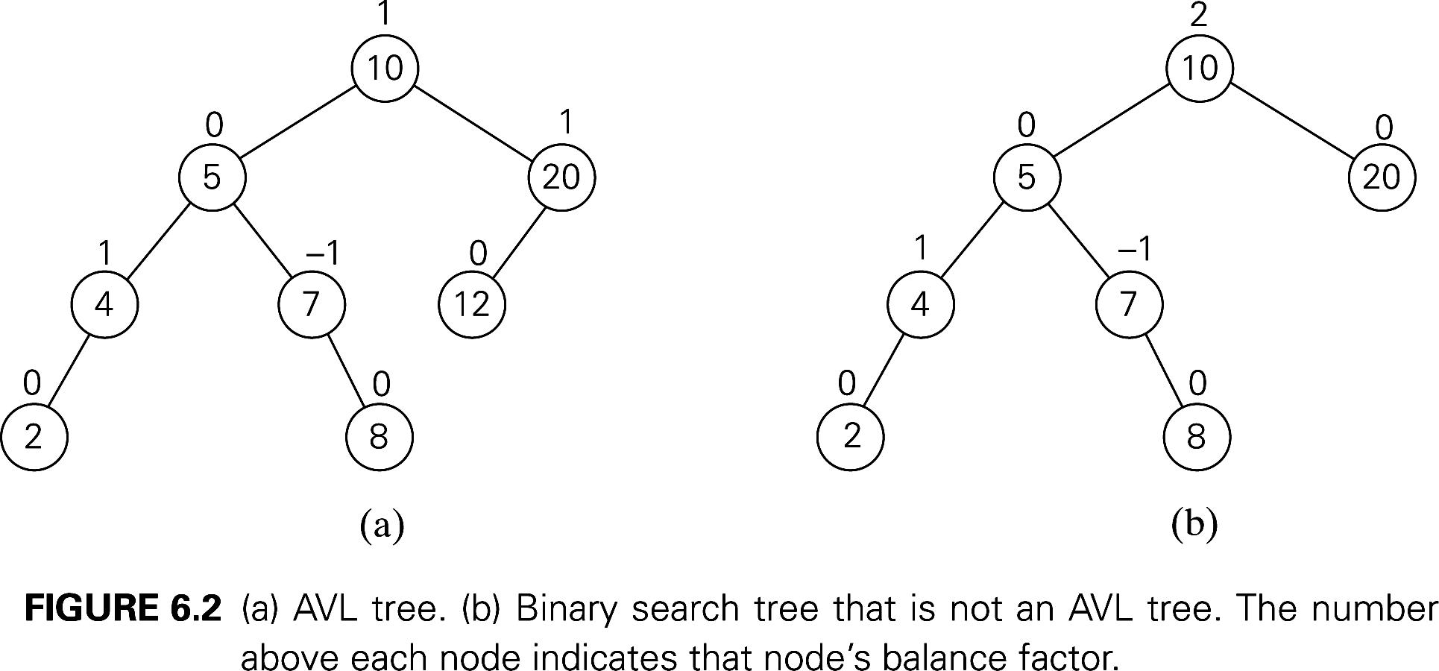
Balanced trees: AVL trees
Definition An AVL tree is a binary search tree in which, for every node, the difference between the heights of its left and right subtrees, called the balance factor, is at most 1 (with the height of an empty tree defined as -1)
Topic: Balanced Search Trees
Notes:
One of the most well-known self-balancing trees is the AVL Tree.
In an AVL tree, the difference between the heights of the left and right subtrees, known as the balance factor, must never exceed 1.
If any insertion or deletion disrupts this balance, the tree will rebalance itself using rotations.
The diagram on this slide compares an AVL tree with a regular BST, highlighting how balance factors help maintain a more efficient tree structure

Slide 29
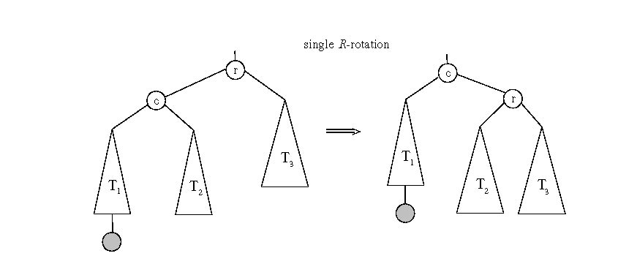
Rotations – single R rotation
If a key insertion violates the balance requirement at some node, the subtree rooted at that node is transformed via one of the four rotations. (The rotation is always performed for a subtree rooted at an “unbalanced” node closest to the new leaf.)
Topic: Balanced Search Trees
Notes:
AVL trees maintain balance using rotations when an insertion disrupts the balance factor.
A single right rotation is used when a node is inserted into the left subtree of another left-heavy node.
This rebalances the tree by shifting the right child of the left-heavy node upwards.
Rotations are a simple yet effective way to maintain logarithmic height, ensuring efficient BST operations

Slide 30
Rotations – single L rotation
If a key insertion violates the balance requirement at some node, the subtree rooted at that node is transformed via one of the four rotations. (The rotation is always performed for a subtree rooted at an “unbalanced” node closest to the new leaf.)
Topic: Balanced Search Trees
Notes:
Similar to the right rotation, a single left rotation is used when a node is inserted into the right subtree of another right-heavy node.
It rebalances the tree by shifting the left child of the right-heavy node upwards.
This ensures that the height difference between left and right subtrees does not exceed 1.
These single rotations help AVL trees stay balanced after insertions.

Slide 31
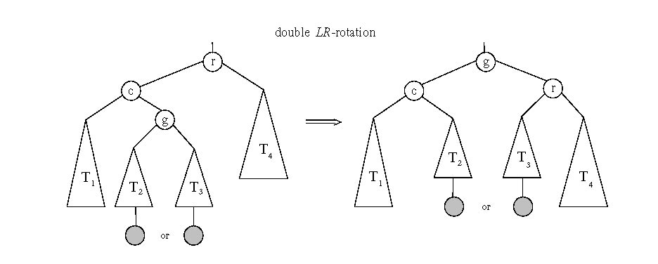
General case: Double LR-rotation
Topic: Balanced Search Trees
Notes:
In some cases, a single rotation is not enough to restore balance. This happens when:
A node is inserted into the right subtree of a left-heavy node.
A node is inserted into the left subtree of a right-heavy node.
To fix this, we perform a double LR rotation, which consists of:
A left rotation on the left child.
A right rotation on the unbalanced node.
This sequence ensures that the tree maintains proper balance and structure.

Slide 32
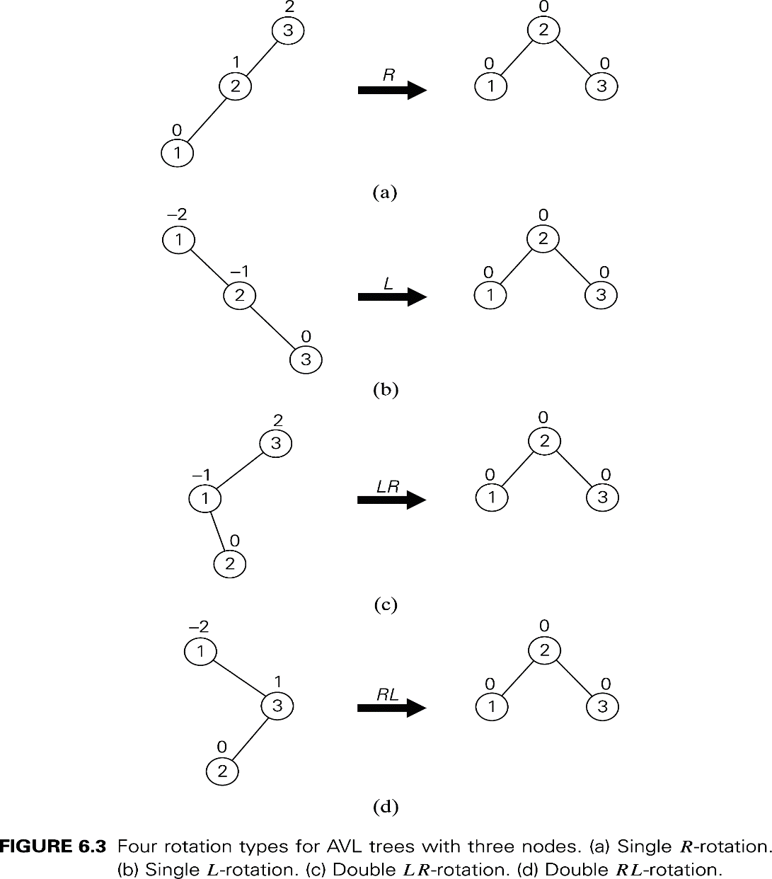
Rotations
Topic: Balanced Search Trees
Notes:
This slide provides an overview of all four types of AVL rotations:
Right Rotation (R) – Fixes left-heavy imbalances.
Left Rotation (L) – Fixes right-heavy imbalances.
Left-Right (LR) Rotation – Fixes when an insertion occurs in the right subtree of a left-heavy node.
Right-Left (RL) Rotation – Fixes when an insertion occurs in the left subtree of a right-heavy node.

Slide 33
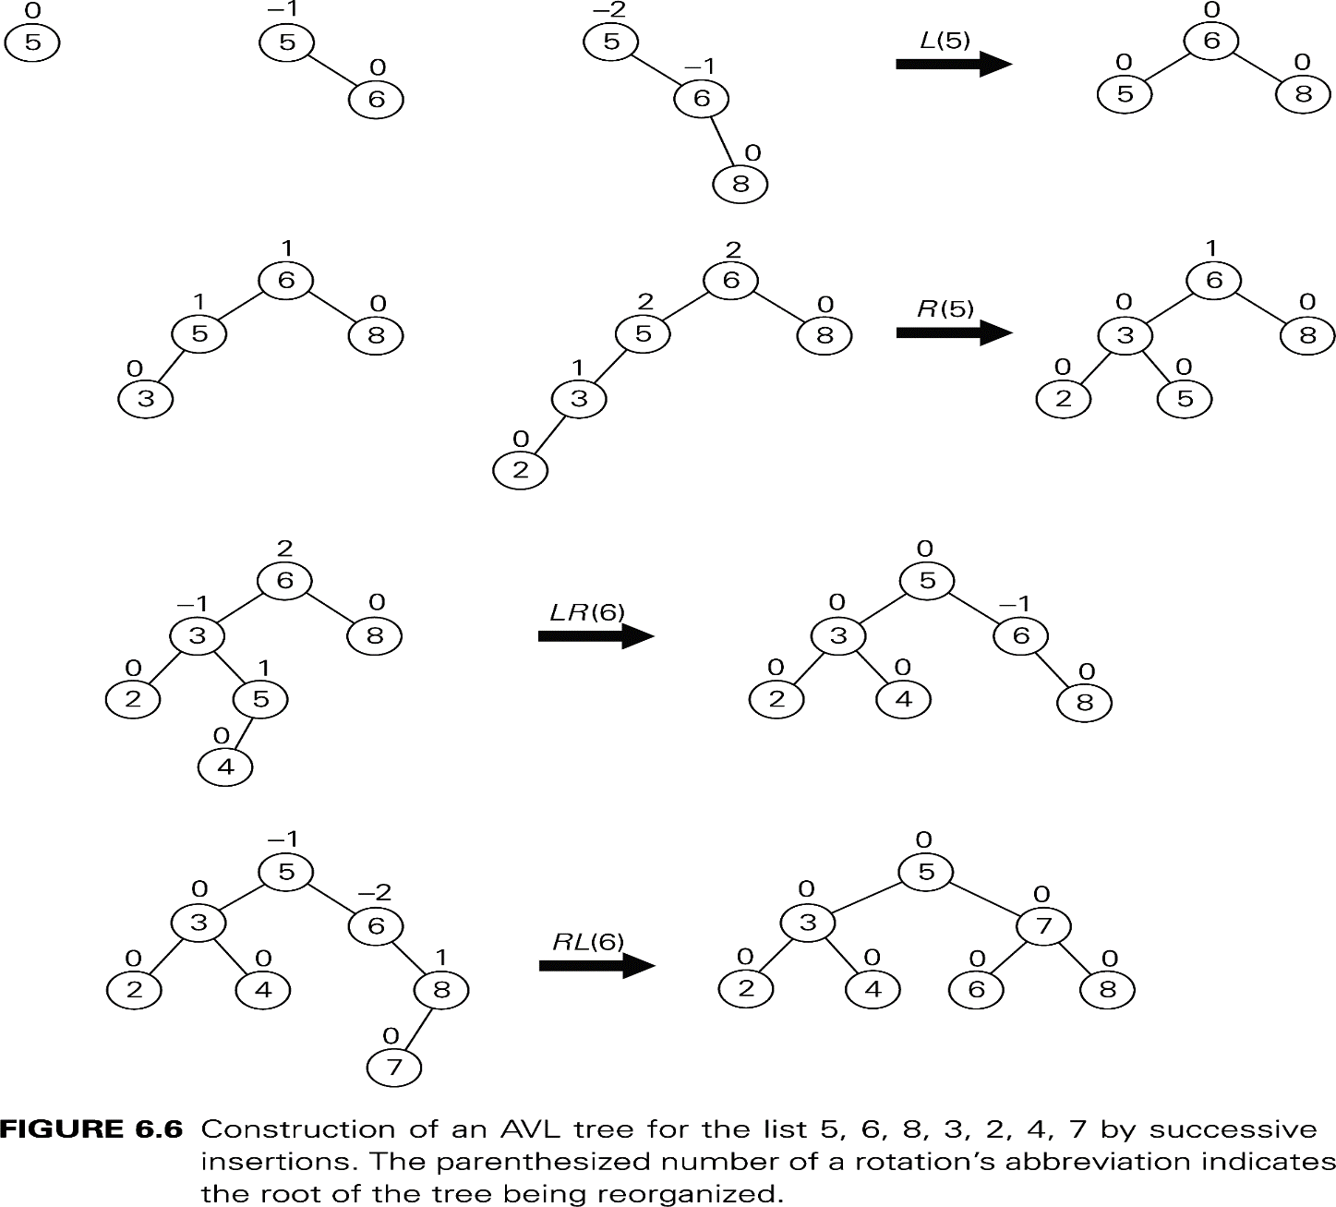
AVL tree construction - an example
Construct an AVL tree for the list 5, 6, 8, 3, 2, 4, 7
Topic: Balanced Search Trees
Notes:
Let’s walk through the process of constructing an AVL tree using the given list of numbers: 5, 6, 8, 3, 2, 4, and 7. Our goal is to maintain balance as we insert each value.
Step 1: Insert 5, then 6. Since 6 is greater than 5, it becomes the right child.
Step 2: Insert 8. The tree now leans to the right, causing an imbalance. To correct it, we perform a Left Rotation (L) at node 5 to restore balance.
Step 3: Insert 3, then 2. The tree now leans to the left, leading to another imbalance. This is corrected by performing a Right Rotation (R) at node 5.
Step 4: Insert 4, which fits in without causing an imbalance.
Step 5: Insert 7, which makes the tree unbalanced again. This time, we need a Right-Left (RL) rotation at node 6 to restore balance.

Slide 34
Analysis of AVL trees
h ≤ 1.4404 log₂ (n + 2) - 1.3277
average height: 1.01 log₂n + 0.1 for large n (found empirically)
Search and insertion are O(log n)
Deletion is more complicated but is also O(log n)
Disadvantages:
frequent rotations
complexity
A similar idea: red-black trees (height of subtrees is allowed to differ by up to a factor of 2)
Topic: Balanced Search Trees

Slide 35
Heaps
Data structure used to implement the priority queue ADT
insert(key, element)
removeMin()
Can be implemented with a tree (link-based) or with an array
Let’s look at tree first
2
5
6
9
7
Topic: Heaps
Notes:
Shifting gears, let’s now explore Heaps—another essential tree-based data structure.
Definition: A heap is a binary tree used for priority queues, supporting:
insert(key, element) → Adds an element.
removeMin() → Removes the smallest (or largest) element.
Implementation:
Can be built using a tree structure (node-based).
Alternatively, can be stored in arrays, where elements are indexed sequentially.

Slide 36
Heap Properties
Binary
Each node has at most two children
Key (or “priority”) at each node
Heap order
for min-heap: n.key ≥ n.parent.key
for max-heap: n.key ≤ n.parent.key
Left-complete
Height O(log n)
2
5
6
9
7
Topic: Heaps
Notes:
What makes a heap different from a BST? Here are the key properties:
Binary Structure: Each node has at most two children.
Heap Order Property:
In a Min-Heap, the parent node’s key is always smaller than or equal to its children’s keys.
In a Max-Heap, the parent node’s key is always larger than or equal to its children’s keys.
Left-Complete: Nodes are filled from left to right to maintain a compact structure.
Height Efficiency: The height is always O(log n), ensuring fast operations.
Because of these properties, heaps provide efficient priority queue operations.

Slide 37
Heaps and Priority Queues
We can use a heap to implement a priority queue
We store a (key, element) item at each node
For simplicity, we will show only the keys in the following pictures
(2, Nick)
(5, Marley)
(6, David)
(9, Pat)
(7, Sarah)
Topic: Heaps
Notes:
A common use case for heaps is implementing priority queues, where elements are assigned priorities and processed accordingly.
Storage: Each node contains a (key, value) pair, such as:
(5, Marley), (2, Nick), (6, David), etc.
Priority Rule:
In a Min-Heap, the element with the lowest key (highest priority) is always at the root.
In a Max-Heap, the element with the highest key (highest priority) is at the root.
By maintaining heap order, we ensure efficient extraction of priority elements.

Slide 38
insert()
We must keep track of the next spot where we will insert to keep the tree left-complete: the “insertion node”
2
5
6
9
7
insertion node
Topic: Heaps
Notes:
When inserting a new node into a heap, we must maintain the left-complete structure.
Insertion Node: The next available position in the heap where the new element will be placed.
Process:
Identify the insertion node.
Place the new element there.
Check if heap order is violated and restore order if necessary.

Slide 39
insert() (2)
Example: insert(1)
Put the new node where the insertion node was
2
5
6
9
7
1
Topic: Heaps
Notes:
Now, let’s insert the number 1 into the heap.
The number 1 is placed at the identified insertion node.
However, the heap order property might not be maintained yet.
If the parent node has a larger key, we will need to bubble-up the new element.
Next, let’s examine what happens when the heap order is violated.

Slide 40
insert() (3)
But now heap order is violated
2
5
6
9
7
1
Topic: Heaps
Notes:
Now that we have inserted 1, we need to check whether the heap order is still valid.
Since 1 is smaller than its parent, the heap property is violated.
To restore order, we must perform a bubble-up operation, swapping the new node with its parent until the heap order is restored.
This process ensures that the smallest element remains at the root of a min-heap.

Slide 41
Upheap
Repair heap order by swapping the new item up the tree until all keys are properly sorted
The first swap fixes everything underneath the new location
Note that since all keys beneath the 6’s old location must have been greater or equal to 6, they must be greater than or equal to 1
2
5
1
9
7
6
Topic: Heaps
Notes:
When inserting a new node in a heap, it is first placed in the next available position to maintain completeness.
However, this may violate the heap order property, which requires that in a min-heap, every parent must be smaller than its children.
The newly inserted 1 is smaller than 6, so we swap them.
This ensures that all elements beneath the swapped node remain in order, and we move towards fully restoring the heap.

Slide 42
Upheap (2)
One more swap, because the 1 is less than the 2 on top
Now both the completeness and the heap order properties are satisfied
1
5
2
9
7
6
Topic: Heaps
Notes:
Even after one swap, the heap order may still be violated.
In this case, 1 is still smaller than 2, meaning another swap is necessary.
The second swap moves 1 to the root, ensuring that the heap is now both:
Complete (all levels filled from left to right).
Properly ordered (smallest element at the top).
Now, the heap properties are fully restored, and no more swaps are required.

Slide 43
Upheap (3)
After the insertion of a new key k, the heap order property may be violated
The upheap algorithm restores the order by swapping k along an upward path from the insertion node
Upheap terminates when the key k reaches the root or a node whose parent has a key smaller than or equal to k
Since a heap has height O(log n), upheap runs in O(log n) time
Topic: Heaps
Notes:
The upheap algorithm is a systematic approach to restoring heap order:
Compare the newly inserted node with its parent.
If the node is smaller, swap it with the parent.
Repeat the process until the node reaches the root or finds a parent smaller than itself.
This ensures that every insertion runs in O(log n) time, as the number of swaps is at most the height of the tree.

Slide 44
Upheap (4)
2
5
1
9
7
6
1
5
2
9
7
6
Topic: Heaps
Notes:
This visual shows the step-by-step process of the upheap operation.
The newly inserted node moves upward, swapping with its parent when needed.
Each swap preserves the overall structure and guarantees an efficient logarithmic runtime.
After reaching its correct position, heap properties are fully restored.

Slide 45
removeMin()
The minimum element of the heap is always the root due to heap order
How do we remove the root of the heap without destroying the ordering?
2
5
6
BAD
5
6
9
7
9
7
Topic: Heaps
Notes:
Can we just take the root out and return it?
Problem: the the root is empty – this is not a complete binary tree
In a min-heap, the smallest element is always at the root.
Removing it directly would leave a hole and break the heap structure.
A better method is needed to remove the root while keeping the heap organized.

Slide 46
removeMin() (2)
Instead swap the root (which we want to remove) with the last item in the heap
Removing from the last position is easy
But now heap order isn’t preserved…
2
7
7
GOOD
GOOD
5
6
5
6
5
6
9
7
9
2
9
Topic: Heaps
Notes:
Uh oh, heap order isn’t preserved…
Need to swap with one of the root’s children
pick the smaller one
Instead of removing the root directly, we swap it with the last element in the heap.
This makes removal easier, as deleting the last node is straightforward.
However, the new root might not satisfy the heap order, requiring further adjustments using downheap (sink-down).

Slide 47
Downheap
Swap the root down as necessary
Now the heap is in order
What if 7 were a 20?
7
5
6
9
GOOD
5
7
6
9
Topic: Heaps
Notes:
Downheap is a key operation in maintaining the heap order property when the root node is removed or displaced. It ensures that the smallest element remains at the root.
Understanding the Downheap Process:
The root node is checked against its two children.
It is swapped with the smaller of its two children if it violates the heap order.
The process repeats along the tree until the node reaches a correct position.
Analyzing the Graph:
Initially, the heap has 7 at the root, with 5 and 6 as its children.
Since 5 is smaller than 7, they swap places.
After the swap, the tree restores the heap order.
This process guarantees that the minimum element is always at the root, preserving the heap’s structural integrity.

Slide 48
Downheap (2)
Downheap restores the heap order property by swapping key k along a downward path from the root, swapping with the lesser of the two children
Downheap terminates when key k reaches a leaf or a node whose children have keys greater than or equal to k
Since a heap has height O(log n), downheap runs in O(log n) time
Topic: Heaps
Notes:
Downheap ensures the heap order property is maintained by moving a node down the tree.
Key Steps:
The node swaps with the smaller of its two children.
The process repeats until:
The node becomes a leaf.
The node is larger than both children.
Efficiency:
Since a heap is a complete binary tree, its height is O(log n).
Therefore, downheap runs in O(log n) time, making it an efficient operation for maintaining heap order.

Slide 49
Heap Implementation Recap
insert():
Insert item into the “insertion node,” the next available spot (which you must keep track of)
Upheap from the bottom as necessary
removeMin():
Swap root with last item in heap
Delete swapped root
Downheap from the root as necessary
Topic: Heaps
Notes:
This slide provides a summary of the two main heap operations: insertion and removal.
1. Inserting an Element (insert())
The new element is placed at the insertion node (the next available position).
Upheap is performed to ensure heap order is restored.
2. Removing the Minimum Element (removeMin())
The root (which holds the smallest element) is swapped with the last item.
The last element is deleted.
Downheap is performed to reposition the new root correctly.
These operations ensure that the heap maintains its structure efficiently.

Slide 50
Finding the Insertion Node
The insertion node can be found by traversing a path of O(log n) nodes
Start with the last added node
Go up until a left child or the root is reached
If a left child is reached, go to its sibling (the corresponding right child)
Go down left until a leaf is reached
Topic: Heaps
Notes:
Inserting an element into a heap requires locating the next available position, known as the insertion node.
Finding the Insertion Node:
Start from the last inserted node.
Move up until a left child or the root is reached.
If a left child is encountered, move to the right sibling.
Move down left until a leaf node is found.
Graph Analysis:
The dashed arrows in the diagram represent the movement from the last inserted node to find the correct insertion node.
The traversal process follows a predictable pattern in a complete binary tree.

Slide 51
Finding the Insertion Node (2)
This is O(log n) but it can also be done in constant time using an additional data structure.
Topic: Heaps
Notes:
The process of finding the insertion node can be optimized.
Optimization:
Instead of traversing the tree, we can store the next available position in an auxiliary data structure.
This reduces the time complexity from O(log n) to O(1).
This optimization is valuable in real-world applications where insertions are frequent.

Slide 52
Array-based Implementation
We can represent a heap with n keys by means of an array of length n + 1
Implementation
For the node at index i
the left child is at index 2i
the right child is at index 2i + 1
Leaves and edges (links between nodes) are not represented
The cell at index 0 is not used
Operations
insert corresponds to inserting at index n + 1
removeMin corresponds to swap with index n and remove
2
5
6
9
7
2
5
6
9
7
0
1
2
3
4
5
Topic: Heaps
Notes:
A heap can be efficiently implemented using an array, which simplifies storage and access.
How Array Representation Works:
Each node at index i has:
Left child at index 2i.
Right child at index 2i + 1.
The heap structure is maintained without storing explicit pointers.
Operations:
insert() places a new element at index n+1 and performs upheap.
removeMin() swaps the root with the last element, removes it, and performs downheap.
Graph Analysis:
The diagram shows how a heap structure maps onto an array.
The array stores elements in level order, ensuring efficient operations.

Slide 53
Priority Queue Motivation
Many problems are solved by maintaining a collection of items and assigning each a priority
Examples:
Plane departures
Different flights require the runway
Some flights are higher priority than others
Bandwidth management
Highest priority data (real-time traffic like Skype, for example) is transmitted first
Topic: Priority Queues
Notes:
Many real-world problems involve managing a collection of items where each item has an associated priority.
Examples:
Plane Departures: Airports handle multiple flights, but some require priority access to the runway due to emergencies, tight schedules, or other constraints.
Bandwidth Management: In network systems, high-priority traffic such as real-time video calls (e.g., Skype) is given precedence over lower-priority traffic to ensure seamless communication.
Priority queues help efficiently manage such problems by always selecting the highest-priority item first.

Slide 54
Priority Queue Abstract Data Type
A priority queue stores a collection of items
An item is a pair: (key, element)
The key defines the element’s position in the queue.
Main methods:
insert(key, element) inserts an item with the specified key and element
removeMin() removes the item with the smallest key and returns the associated element
Topic: Priority Queues
Notes:
A priority queue is a data structure that maintains a collection of items, each with an associated priority.
Each item in the queue is stored as a pair (key, element):
The key determines the priority of the element.
Main operations of a priority queue:
insert(key, element): Adds an item to the queue with a given priority.
removeMin(): Removes and returns the item with the smallest key (highest priority).
The efficiency of these operations depends on the data structure used to implement the priority queue.

Slide 55
Priority Queue Implementations
Implementation | add | removeMin
Unsorted Array | O(1) | O(n)
Sorted Array | O(n) | O(1)
Unsorted Linked List | O(1) | O(n)
Sorted Linked List | O(n) | O(1)
Hash Table | O(1) | O(n)
Heap | O(log n) | O(log n)
Topic: Priority Queues
Notes:
Different data structures can be used to implement a priority queue, each with its own trade-offs in terms of efficiency.
The table presents the time complexity of add and removeMin operations for different implementations:
Analysis:
Unsorted structures (array or linked list): Fast insertion (O(1)) but slow removal (O(n)).
Sorted structures (array or linked list): Fast removal (O(1)) but slow insertion (O(n)).
Heap: Provides the best balance with O(log n) for both operations, making it an efficient choice for priority queues in real-world applications.

Slide 56
Summary
Binary Search Trees (BSTs): Provide efficient search, insertion, and deletion but can become unbalanced, leading to degraded performance.
Balanced Search Trees: AVL trees maintain balance via rotations; Red-Black trees allow a small imbalance for efficiency; B-Trees optimize multi-key searching.
Heaps: Binary heaps support priority queue operations, ensuring efficient insertions (upheap) and deletions (downheap) while maintaining heap order.
Priority Queues: Used in scheduling and resource management, they assign priority to elements and are best implemented with heaps for O(log n) operations.
Notes:
Summary
Binary Search Trees (BSTs): Efficient for searching, insertion, and deletion, but can become unbalanced.
Balanced Search Trees:
AVL Trees: Maintain balance using rotations (R, L, LR, RL).
Red-Black Trees & B-Trees: Ensure logarithmic height for efficiency.
Heaps:
Min-Heap & Max-Heap: Used for priority queues.
Operations: Insert (Upheap), RemoveMin (Downheap).
Array-based storage allows fast indexing.
Priority Queues:
Manage tasks based on priority.
Best implemented using heaps for O(log n) efficiency.
Key Takeaway: Balanced trees and heaps optimize search, insertion, and deletion for real-world applications like scheduling and resource management.

